Slide 1
MARKET ANALYSIS FOR OLIST
E-commerce company

Slide 2
Problem Statement:
OList is a e-commerce company which is facing losses recently. So, they want to manage their inventory to reduce the unnecessary costs.
Identity the Products with High Revenue Generation and Discard or Remove the Non-profitable Products in their Inventory.

Slide 3
Objective:
Identify the Top Products that contributes to Maximum Revenue
Analysis the Purchase behavior of Individuals customers
Customer behavior
Inventory Management

Slide 4
Product Analysis
Based on customer purchases

Slide 5
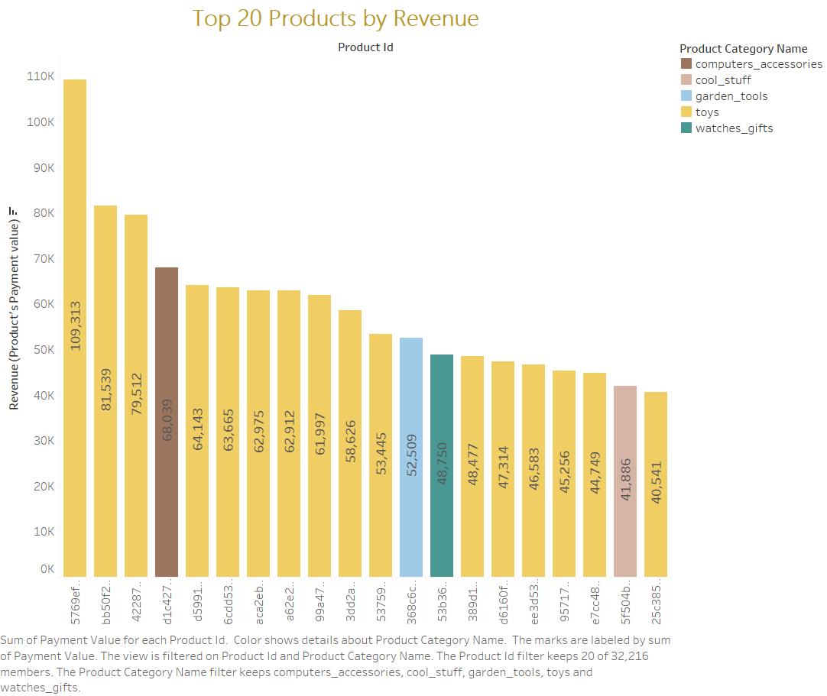
Identifying the Top Twenty Products based on Revenue
The Highest Revenue Generating Product is with the Value 109,313
Most among the top twenty products belongs to TOYS Category
The Highest Revenue Generated Product also belongs to the Toys Category

Slide 6
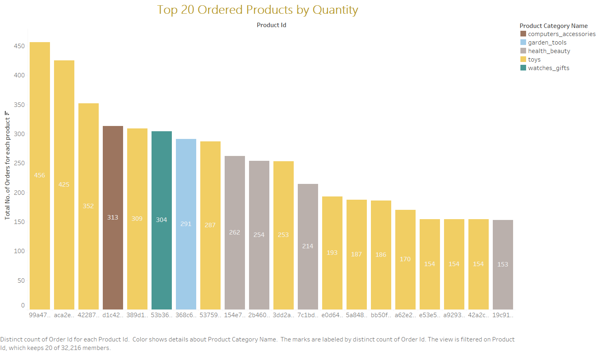
Identifying the Top Twenty Products based on Quantity
The Frequently Ordered Product is 456 times
Most among the top twenty products belongs to TOYS Category
The Frequently Ordered Product also belongs to the Toys Category

Slide 7
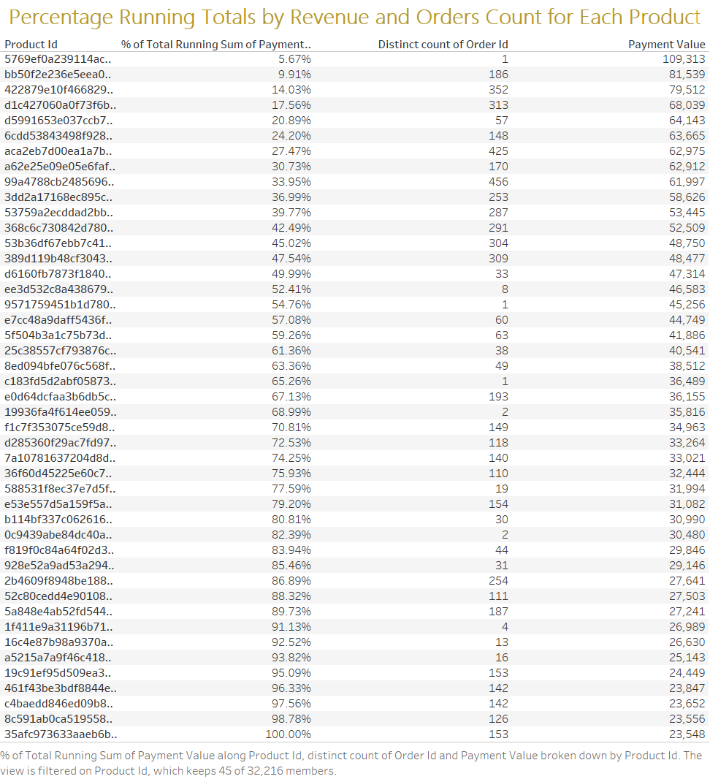
Running Totals by Revenue and Number of Orders
These are some of the Products with there Running totals and the Number of Orders values
The Product with Highest Revenue accounts for 5.67% of Running Total Revenue but its Order count is only Once
We can check Running Totals and Count of Orders for each Product in the Workbook

Slide 8
Market Basket Analysis
Customers preferred products combinations

Slide 9
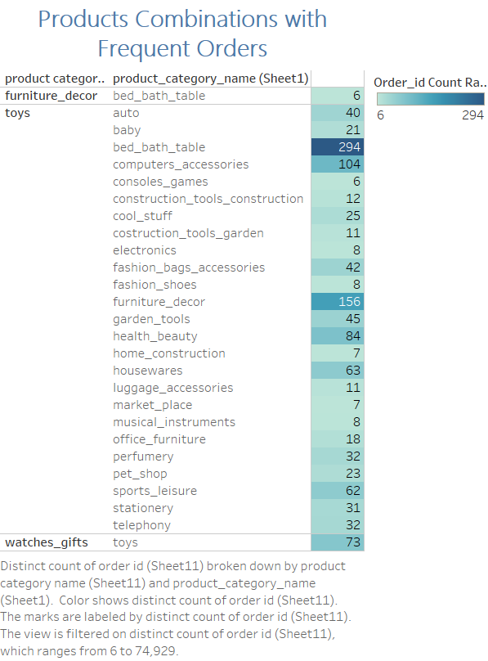
Combinations of Product Categories
The best combination which can be found is toys and bed_bath_table
The Second best combination is toys and furniture_decor
Obviously we can find most of the product combinations is skewed towards toys category due to most number of orders

Slide 10
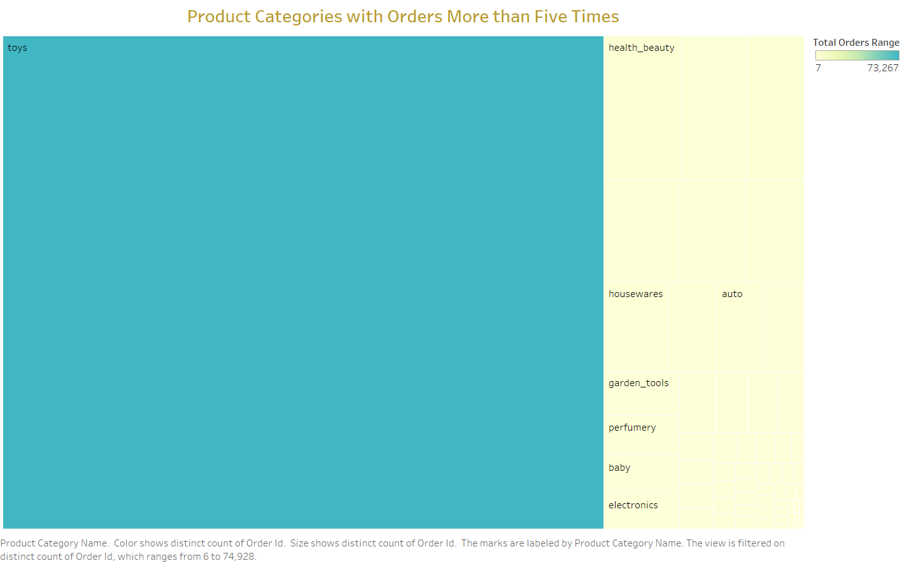
Product Categories with more than 5 times of Orders
Most of the Product Categories contain Toys

Slide 11
Customer Behavior Analysis
Purchase of product

Slide 12
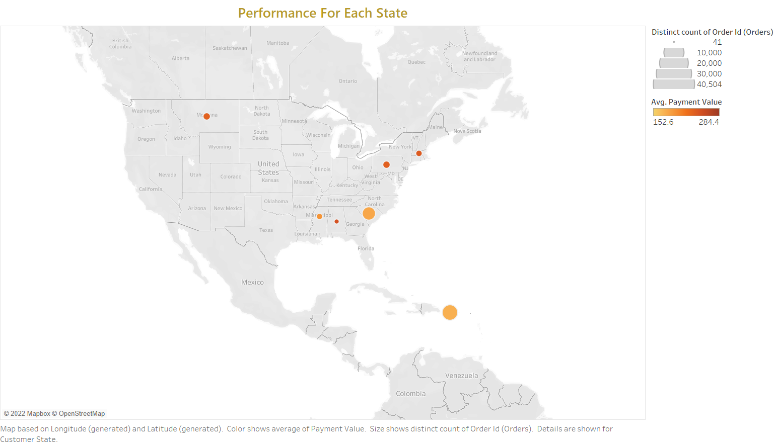
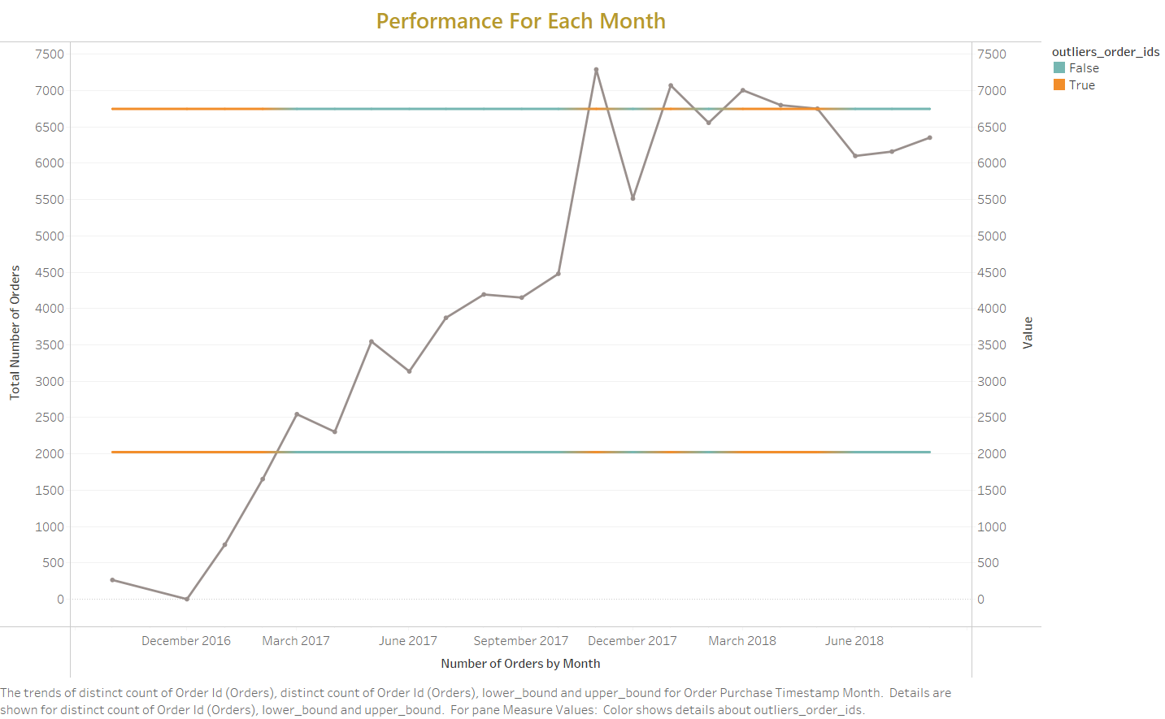
Customers Purchasing Trends
Density of Orders and avg. payment for each state
Purchases trend by month

Slide 13
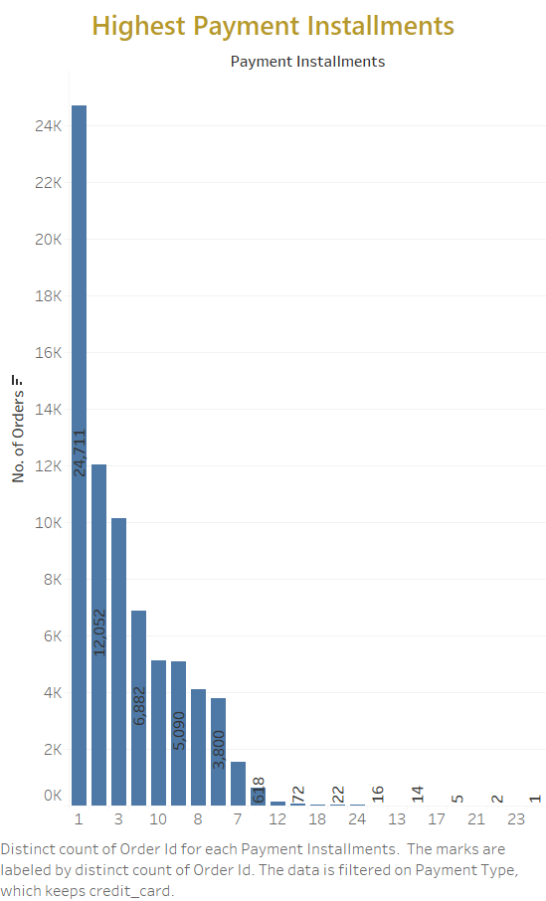
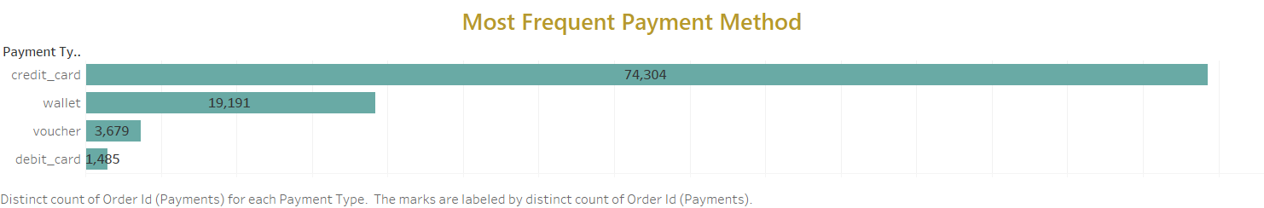
Mode and Process of Payments by Customer
Mode of payment frequently used
Payments done by installments

Slide 14
INVENTORY MANAGEMENT
VOLUME OF THE PRODUCT AND ORDERS

Slide 15
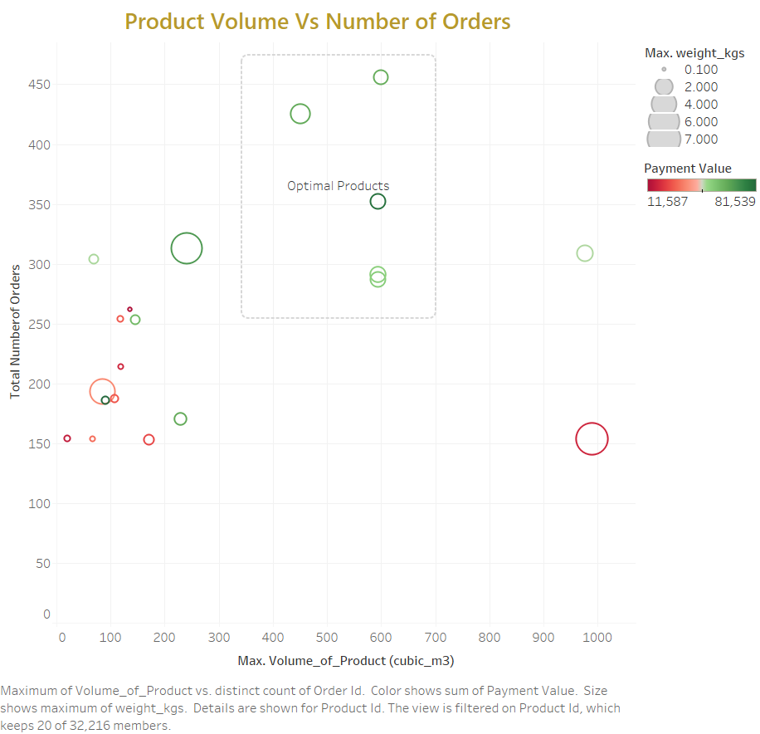
Product Volume Vs Orders
X-axis represents the Volume (cubic_metre) of the Product
Y-axis represents the Total number of Orders
Size of the Circle represent the Weight of the Product
Color palate represents the Revenue of the Product
Red represent low payment Value
Green represent high Payment value

Slide 16
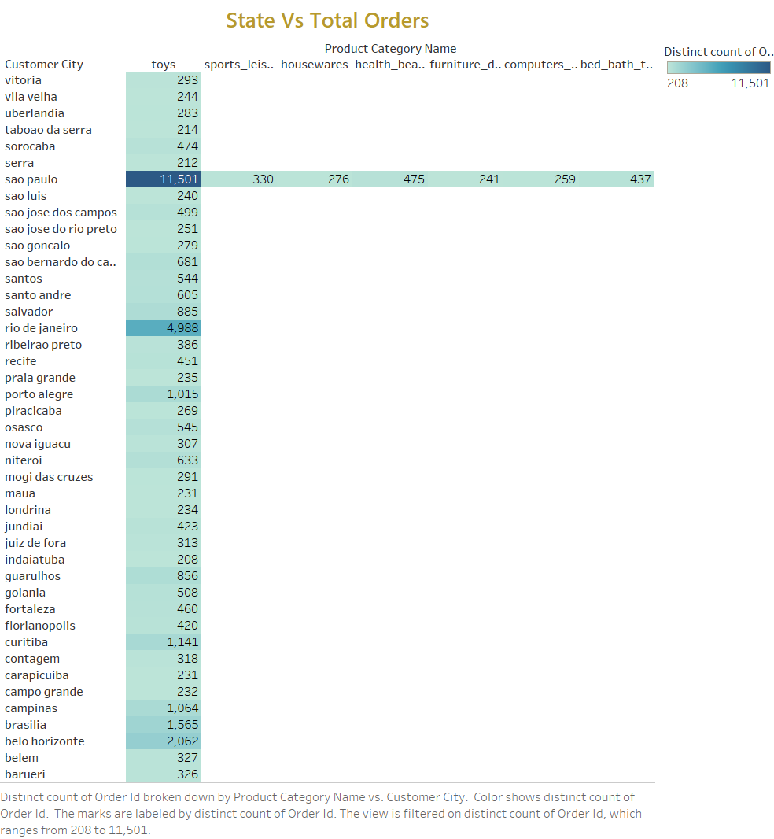
State Vs Product Orders
Total number of Orders Divided for each State according to the Product Category Name
The OList Company which has warehouses in various states can be managed according to the most ordered product categories

Slide 17
Observed insights
The most frequently ordered and highest Revenue generated Product Category is ‘TOYS ‘ and next is ‘Computer accessories’.
The Product with highest number of Orders contributed 5.24% of Running Total and the product with least number of orders contributes 5.67% of Runnig Total. This shows that most ordered product may not always be most Revenue generating product.
Market Basket Analysis shows that best product category combination is “TOYS and BED_BATH_TABLE”.
The states has certain pattern were the count of orders is less but Average Value of the Revenue for that state is High. For example : Alabama state
Customers most used platform for payments was done through Credit card.

Slide 18
recommendations
Among all the Product Categories - Toys and Computer accessories should give Priority and Most of the space in the inventory should be Allocated.
The Product Combinations such as toys & bed_bath_table ,toys & computer accessories, toys & furniture decors should be Rearranged in such a way that they should complimentary to each other.
Focus on the Product Categories according to the particular city’s demands of the products and fill the inventory with those products.
For Maximization of Revenue and reduction of unnecessary expenses for Inventory maintenance
products with less number of orders should be replaced with optimal products.
Optimal Products are those which have High number of Orders and high profit but with minimal in Volume(size) and weight for storage.

